Slide 1

SUBJECT CODE:18MAB102T
ADVANCED CALCULUS
AND
COMPLEX ANALYSIS

Slide 2
Applications of complex analysis

Slide 3
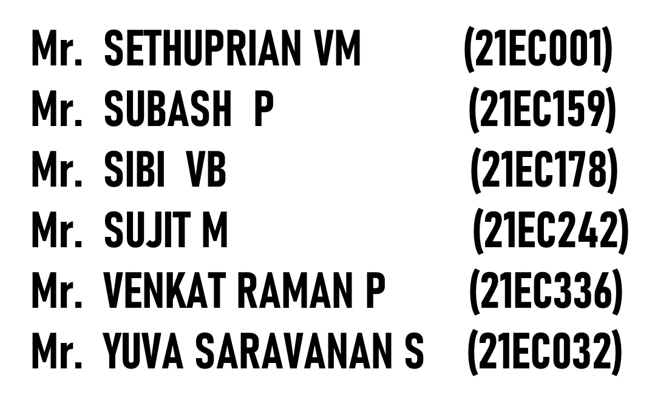

TEAM MEMBERS
(21BEC193)
(21BEC213)
SUBASH S
(21BEC214)
(21BEC221)
(21BEC238)
(21BEC248)

Slide 4
SYNOPSIS:
1.Introduction
2.What is complex number
3.Operations on complex number
4.Graphical representation of complex number
5.Importation of complex number
6.Applications of complex number

Slide 5
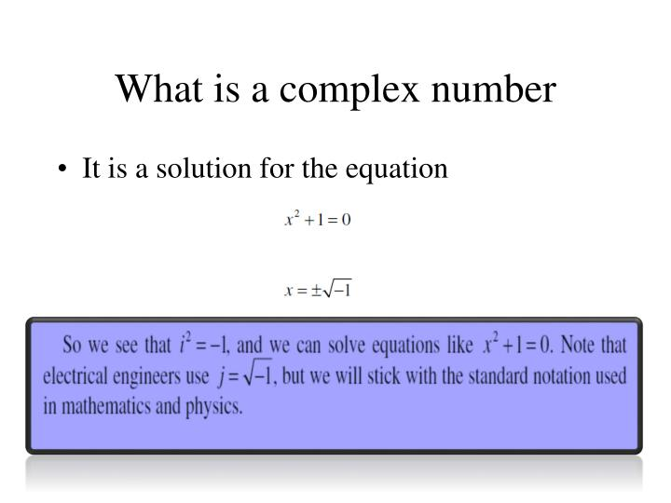

Slide 6
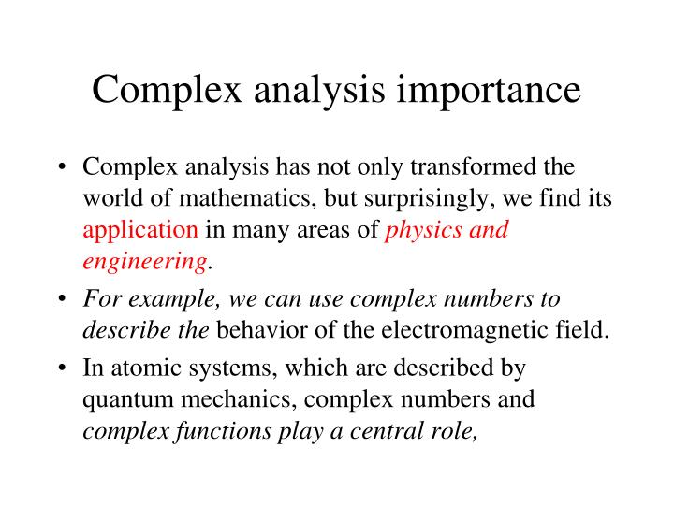

Slide 7
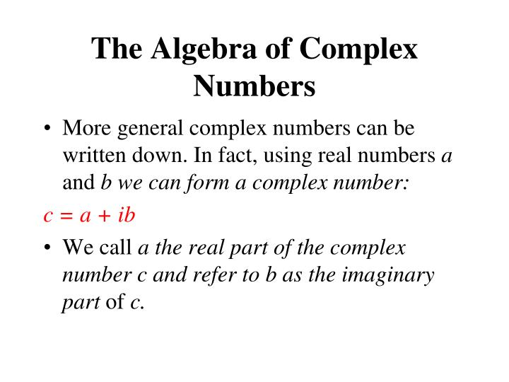

Slide 8
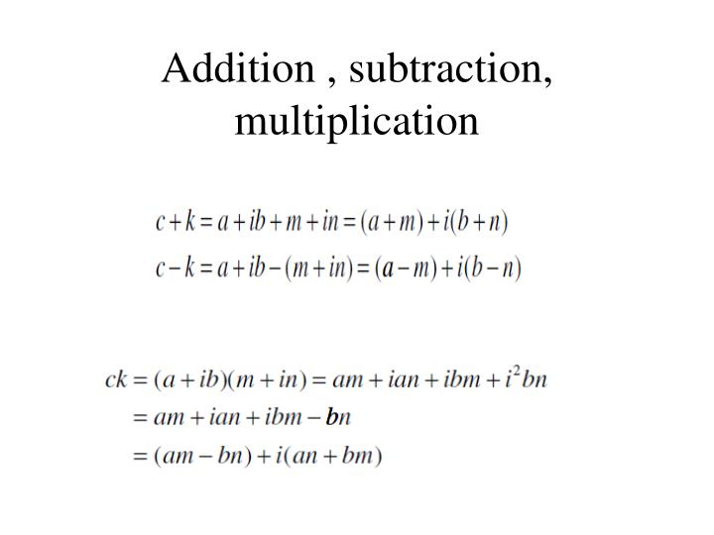
Operations of complex number

Slide 9
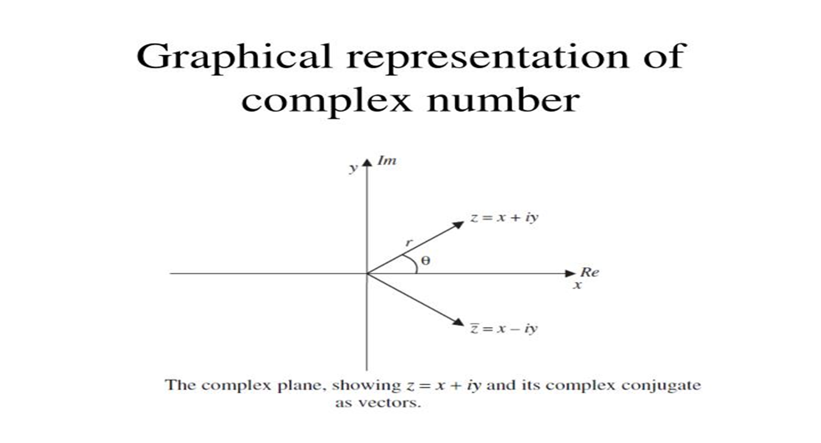

Slide 10
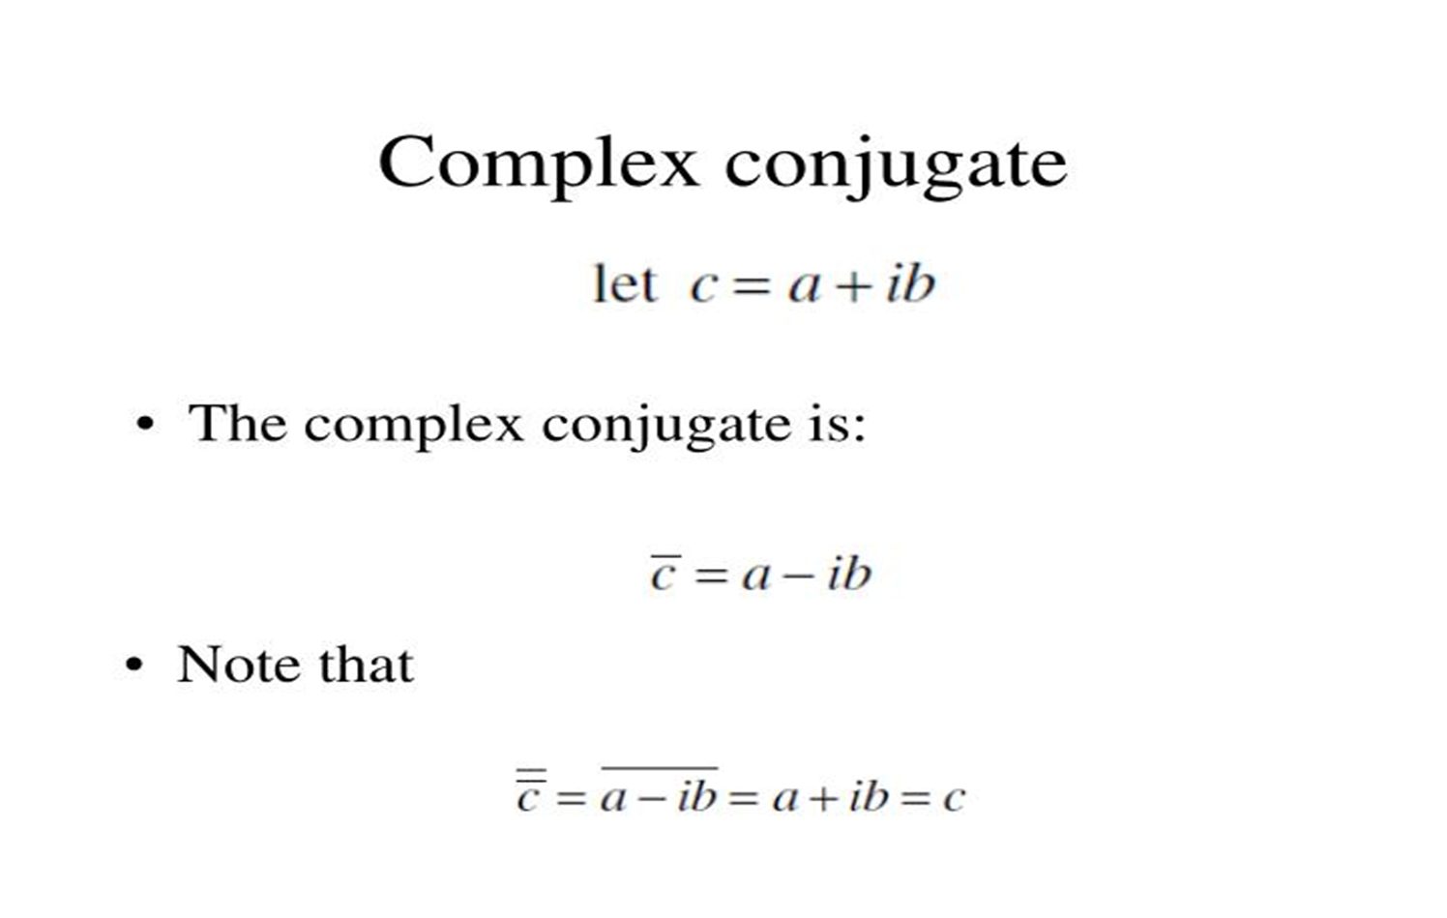

Slide 11
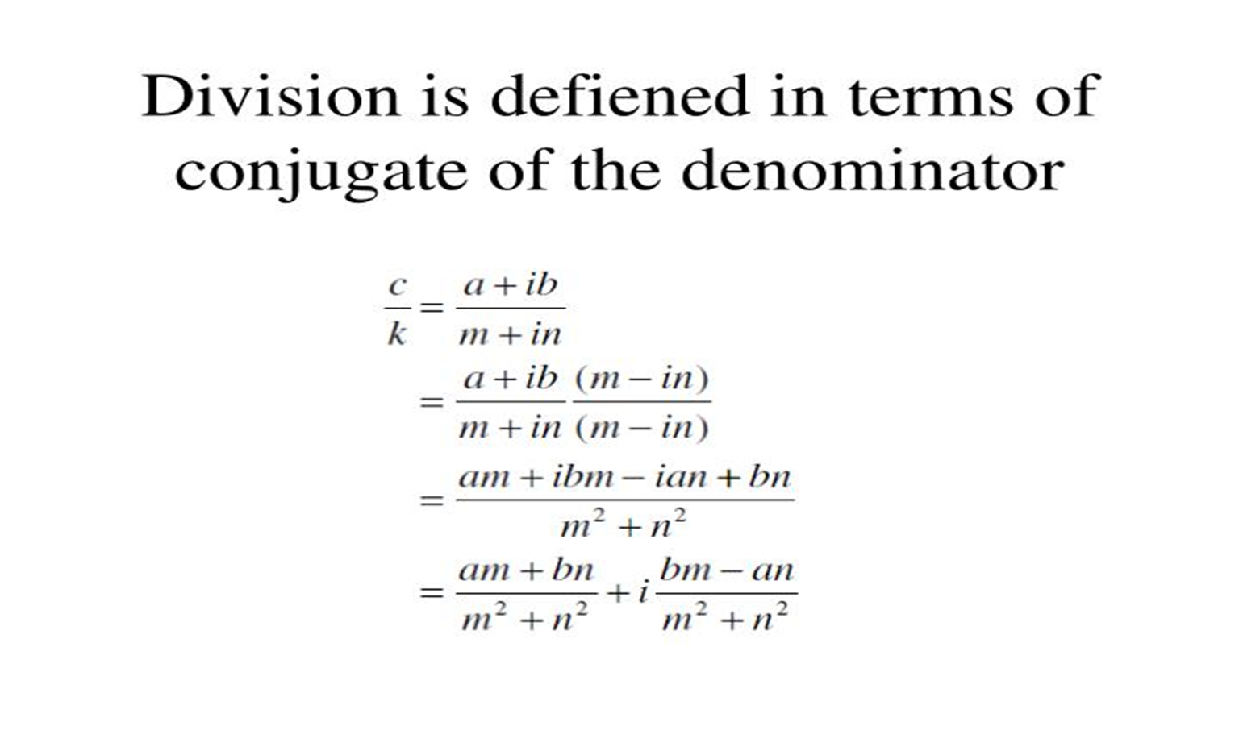

Slide 12
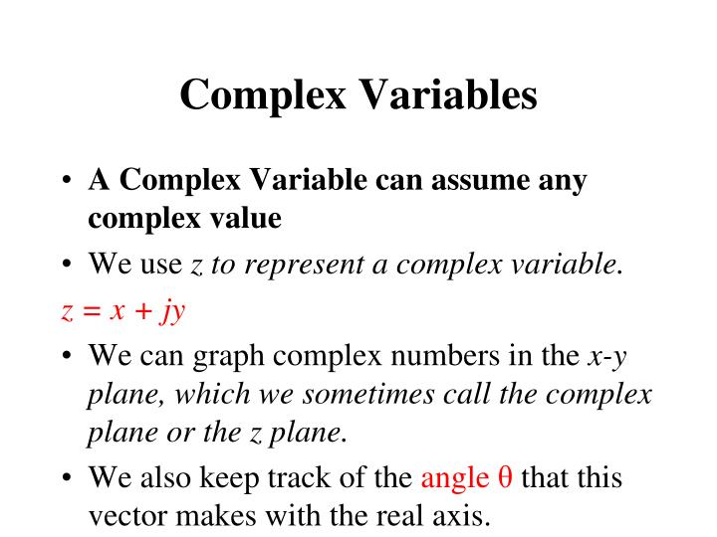

Slide 13
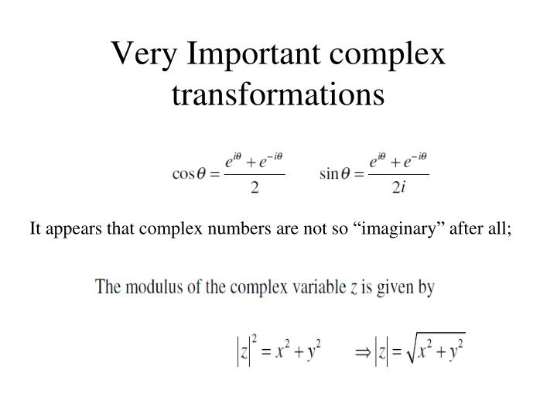

Slide 14
Complex analysis applied math?
1.Complex analysis is important in applied mathematics.
2.Main reasons:
Two dimensional potential problems.
By methods of analytic functions.
3.This is the real and imaginary parts of analytic functions.
4.It satisfy laplace’s equation in two real variables.

Slide 15
What are the applications of complex analysis?
1.The applications of these methods to real world problems.
2.It includes propagation of acoustic waves.
3.It relevants for the design of jet engines,development of boundary.
4.Integral techniques useful for solution of many problems.
5.Problems arising in solid an fluid mechanics as well as conformal geometry in imaging,shape analysis.

Slide 16
Some applications of complex number
Phasor-domain analysis in engineering.
Laplace and fourier transforms.
Evaluation of integrals.
Conformal mapping(solution of laplace’s equation)
Industrial applications of complex number.
Signal processiong of complex number.

Slide 17
Phasor-domain analysis in engineering
Phasor is a complex number that represent magnitude and angle for a sine wave.
Phasor diagram is a vector line that represent magnitude and phase angle of a sine wave.
The magnitude of the phasor is equal to rms value.
For example, if given a sine wave waveform
v(t)=V, sin(ot+0) V

Slide 18
Evaluation of Integration
There are various methods for evaluating integrals.
substitution, integration by parts, partial fractions, using the residue theorem, or Cauchy's integral formula, etc.
A beautiful special technique is the differentiation.
With respect to a parameter inside the integral.

Slide 19
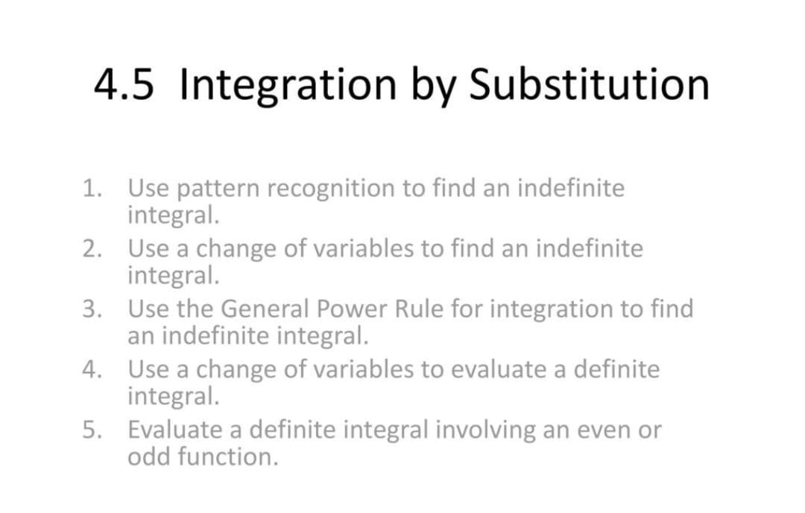

Slide 20
Integration by parts
Using integration by parts
Integration by parts cannot be used for every product.
It works if
We can integrate one factor of the product.
The integration on the r.h.s is easier.
There is an exception but you need to learn the general rule.

Slide 21
Conformal mapping
An analytic function is conformal at point where it has nonzero.
Conversely,any conformal mapping of a complex variable.
It is very important in complex analysis.
As well as in many areas in engineering.

Slide 22
Conformal mapping used for
Conformal mapping can be used in scattering and diffraction problems.
For scattering and diffraction problem of plane electromagnetic waves.
The mathematical problem involves finding a solution to scaler wave function.
which satisfies both boundary condition and radiation condition at infinity.

Slide 23
Fourier transform and laplace transform
The Laplace transform is applied for solving the differential equations.
That relate the input and output of a system.
The Fourier transform is also applied for solving the differential equations.
That relate the input and output of a system.
The Laplace transform can be used to analyse unstable systems.

Slide 24
Industrial applications of complex analysis
There has been surge of activity advancement in recent years complex in industry.
The applications of complex number is used for real word problems.

Slide 25
Signal processing
Signal processing is also used in complex analysis.
Signal processing is use to accuratrly determine the scientific measurement and synthesizing signals.

Slide 26


Slide 27


